Slide 1
云计算技术
陈果 副教授
湖南大学-信息科学与工程学院-计算机与科学系
邮箱：guochen@hnu.edu.cn
个人主页：1989chenguo.github.io

Slide 2
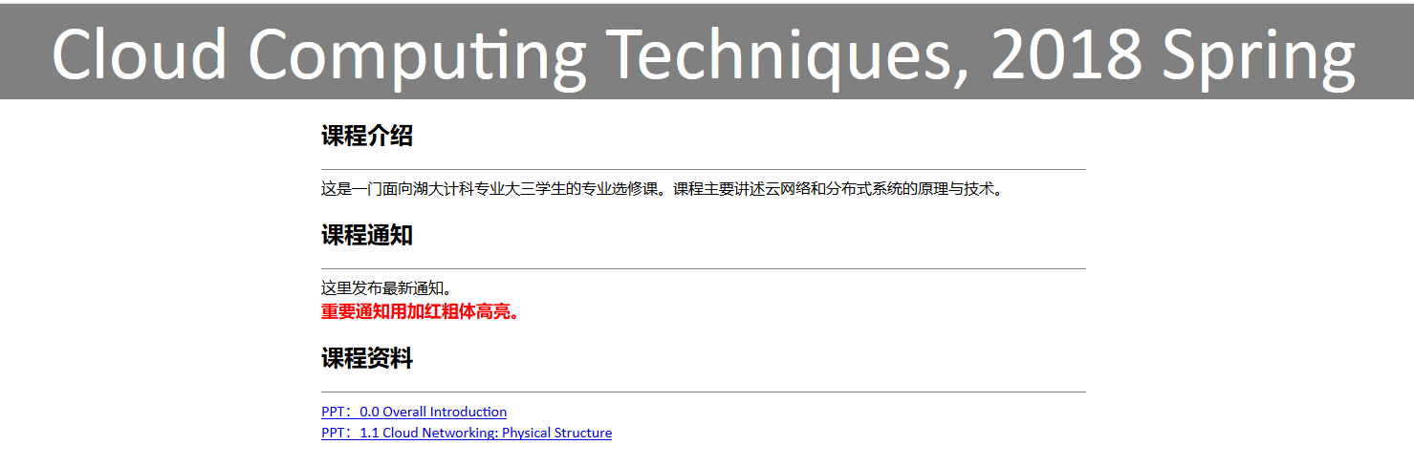
Course website available!
https://1989chenguo.github.io/Courses/CloudComputing2018Spring

Slide 3
Notification to group projects
Form group and tell me whether your group wants to give a presentation
Group leader should email me and CC all TAs (email address on website) before the deadline.
Email title should be
云计算技术2018-项目分组报名-[组长姓名]（E.g., 云计算技术2018-项目分组报名-陈果）
Email should include:
Group member (include leader) information: Name + Class + Student ID
Who is group leader
Whether to give presentation
Deadline: 2018/4/30 11:59 PM
DO NOT miss the deadline, otherwise -20 points
Do not miss the deadline!
Do not miss the deadline!
Do not miss the deadline!

Slide 4
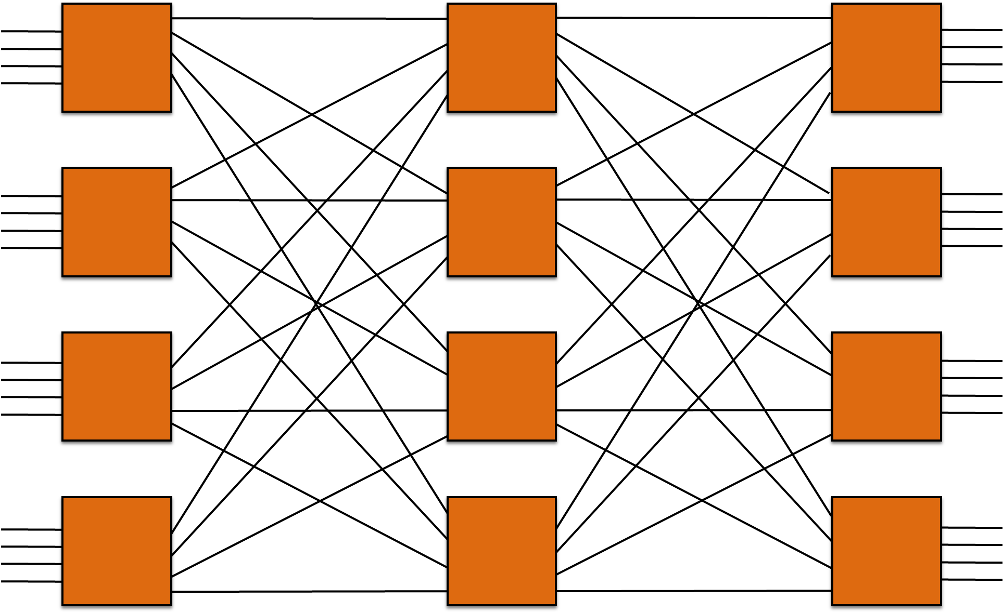
What we have learned
What is cloud computing
Definition
Architecture
Techniques
Cloud Networking
Physical Structure
Scale of Cloud
What Cloud Physically Looks Like
Data center network topology
Clos networks

Slide 5
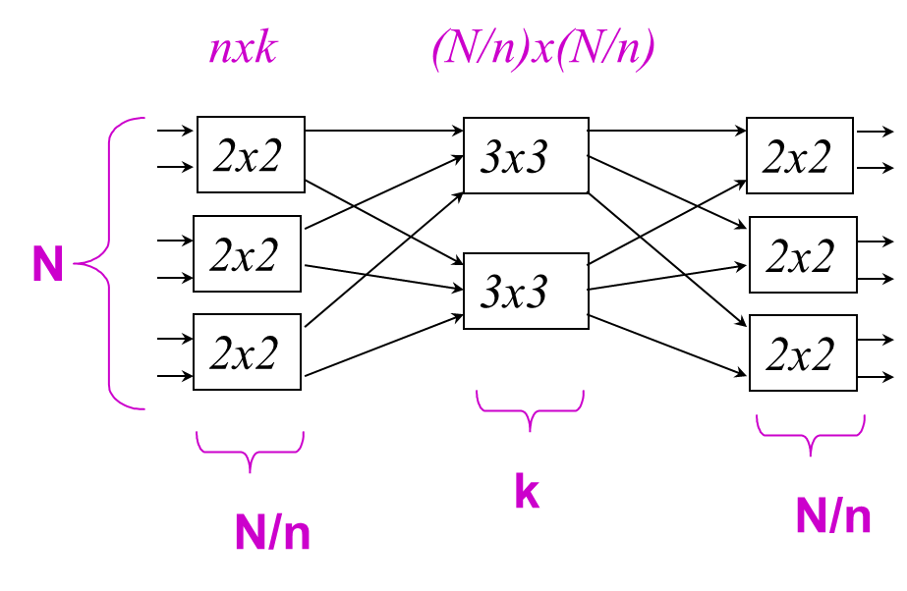
Clos network
Non-blocking types
Re-arrangeable non-blocking
Can route any permutation from inputs to outputs.
Strict sense non-blocking
Given any current connections through the switch, any unused input can be routed to any unused output.
Strict sense non-blocking
If k ≥ 2n-1
Re-arrangeable non-blocking
If k ≥ n
Use small, cheap elements to build large capacity-rich networks

Slide 6
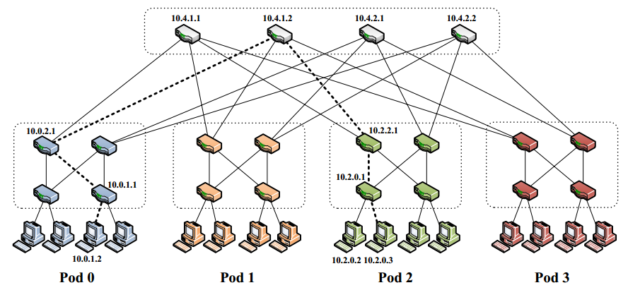
What we have learned
What is cloud computing
Definition
Architecture
Techniques
Cloud Networking
Physical Structure
Scale of Cloud
What Cloud Physically Looks Like
Data center network topology
Fat-tree

Slide 7
Applications and network traffic
Part I: Cloud networking
Most materials from UIUC MOOC
Ankit Singla
ETH Zürich
P. Brighten Godfrey
UIUC
Credits to

Slide 8













Slide 9
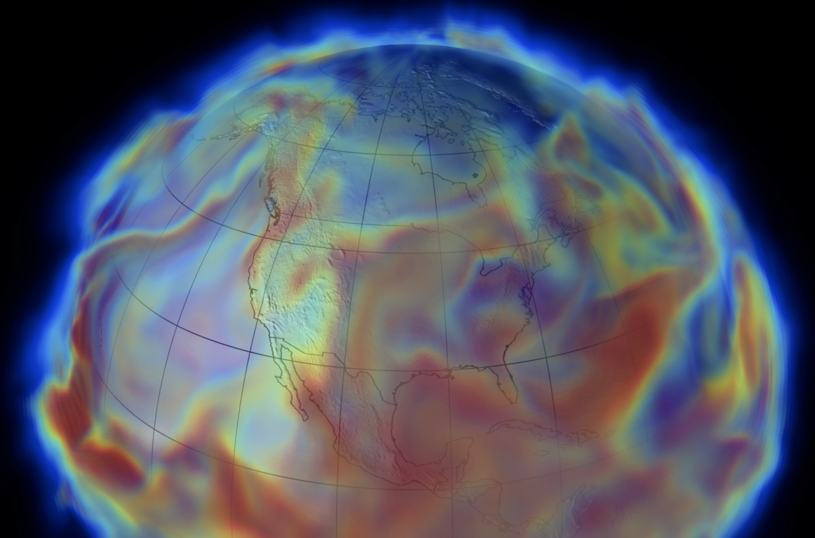
[Image: NASA/Goddard/UMBC]
Notes:
Pretty much every popular Web app —> DC
But DC also run data analytics which make these work, e.g. search index
Such infra also used for “big science” apps like climate modeling (Image: NASA, public use: https://cds.nccs.nasa.gov/tools-services/merra-analytics-service/)
massive amounts of data being moved around inside data centers …

Slide 10

How a Web search works
Notes:
Let’s take a slightly closer look at how something like a Web search query works:
I make a search query

Slide 11

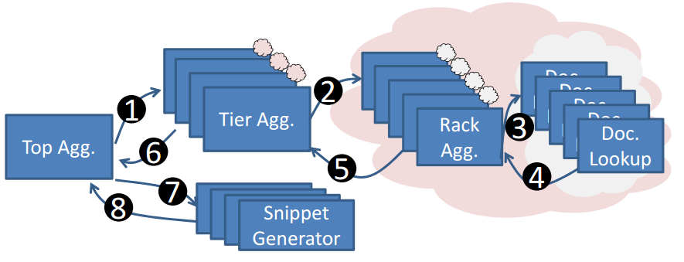
How a Web search works
“Speeding up Distributed Request-Response Workflows”, ACM SIGCOMM’13
Notes:
Let’s take a slightly closer look at how something like a Web search query works:
I make a search query

Slide 12
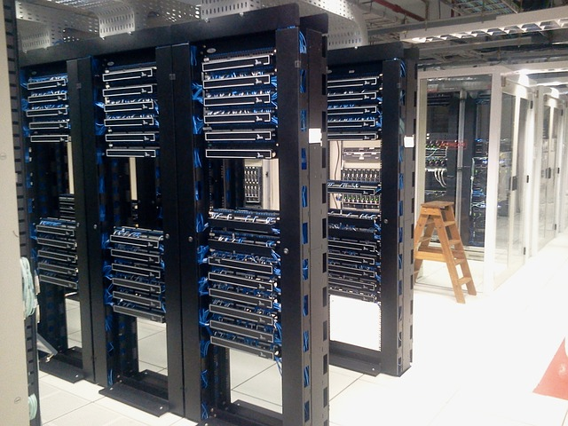
How a Web search works
Notes:
It hits a server in a data center
This server might query several other servers, which further might communicate with …
- Image: free use (https://pixabay.com/en/datacenter-servers-computers-286386/)

Slide 13
How a Web search works
Scatter-gather traffic pattern
Extremely short response deadlines for each server — 10ms
Notes:
These responses are then collated, and the final search response page sent to me
This kind of traffic pattern is referred to as “scatter-gather”, or “partition-aggregate”
For one query, there might be a large number of server-server interactions within the data center
Extremely tight deadlines … (poor result quality on misses)
And really, this illustration is very very simplified …
- Image: free use (https://pixabay.com/en/datacenter-servers-computers-286386/)

Slide 14
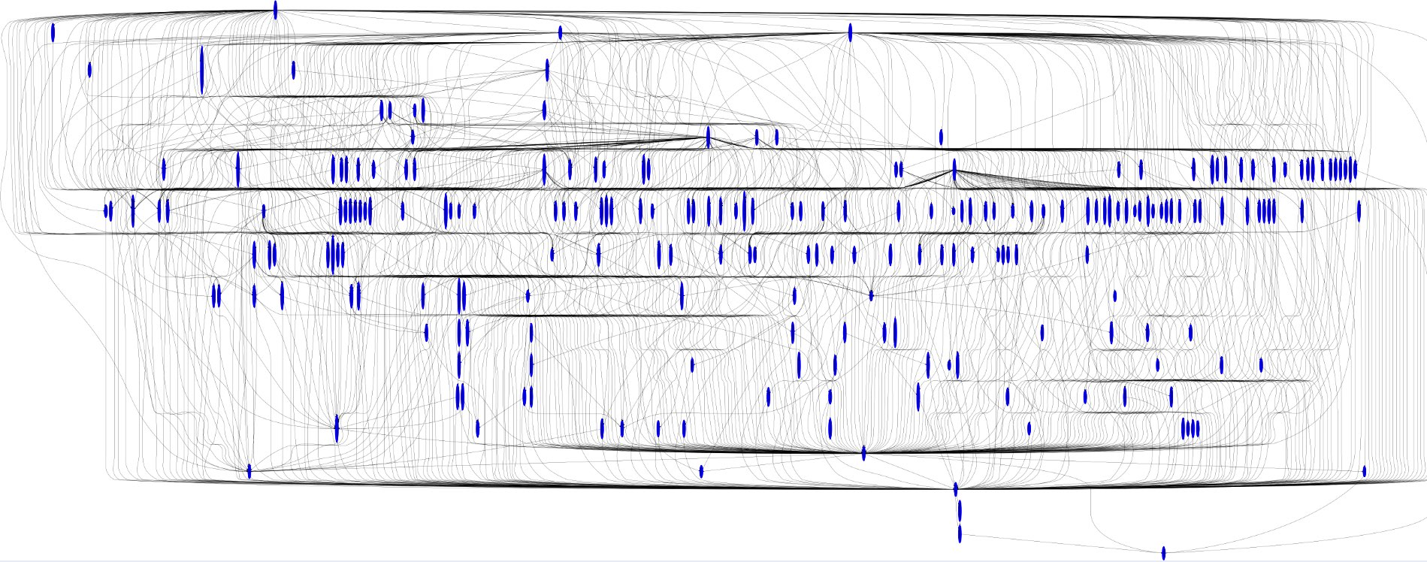
“Up to 150 stages, degree of 40, path lengths of 10 or more”
Request
Scatter
Gather
Response
Image source: Talk on “Speeding up Distributed Request-Response Workflows” by Virajith Jalaparti at ACM SIGCOMM’13
Notes:
this is what Bing’s query workflow for producing the first page results looks like
From the request at the top to the response at the bottom, there may be several stages (like getting search results, making snippets, ads, spellcheck, etc.), with a degree of up to 40 in a stage.
Each stage is internally complex! This one stage, queries 1000s of servers to produce the search results in a partition-aggregate manner.
Not exclusive to search. FB also sees several internal reqs …

Slide 15
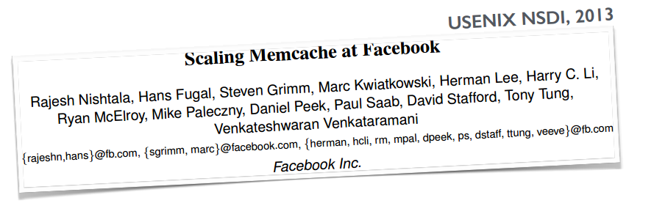
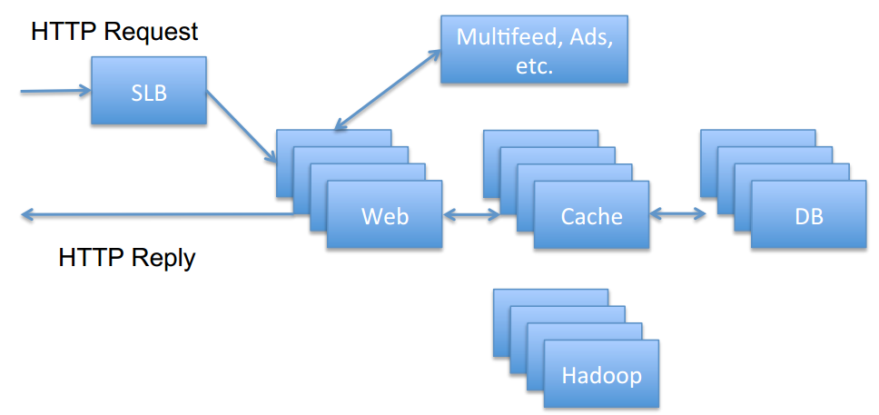

Other Web application traffic
Notes:
Facebook: loading one of their popular pages causes avg. of 521 …
For that page 95-th percentile causes 1740 items!

Slide 16
Other Web application traffic
One popular page loaded ⇒ average of 521 distinct memcache fetches
95th percentile: 1740 distinct memcache fetches
Notes:
Facebook: loading one of their popular pages causes avg. of 521 …
For that page 95-th percentile causes 1740 items!

Slide 17
Big data analytics
Hadoop
Spark
Storm
Database joins
…
Notes:
Further, many applications move large amounts of data
straggling jobs block the whole app and impact result quality
So what does actual measured traffic in these facilities look like?

Slide 18
What does data center traffic look like?
It depends … on applications, scale, network design, …
Notes:
It depends
No “representative” dataset is available
But let’s take a look at some of the published data

Slide 19
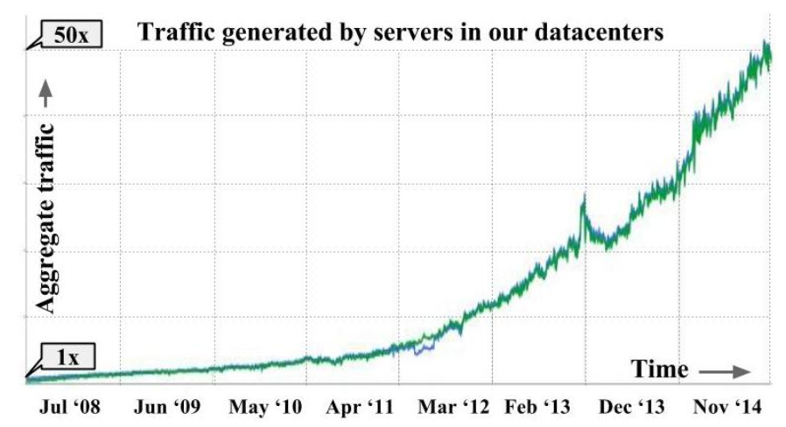
Traffic characteristics: growing volume
“Jupiter Rising: A Decade of Clos Topologies and Centralized Control in Google’s Datacenter Network”, Arjun Singh et al. @ Google, ACM SIGCOMM’15
Notes:
both Web workloads and data analytics drive internal traffic
rapidly growing: doubling roughly every year
(Google paper isn’t clear if this is internal traffic only)
FB: machine-machine traffic inside doubling faster than every year

Slide 20
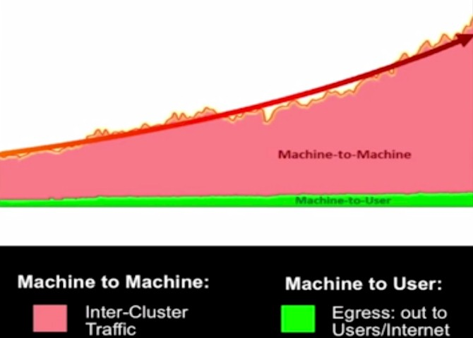
Traffic characteristics: growing volume
Facebook: “machine to machine” traffic is several orders of magnitude larger than what goes out to the Internet
“Introducing data center fabric, the next-generation Facebook data center”, @ Facebook, 2014 Facebook official blog
Notes:
both Web workloads and data analytics drive internal traffic
rapidly growing: doubling roughly every year
(Google paper isn’t clear if this is internal traffic only)
FB: machine-machine traffic inside doubling faster than every year

Slide 21

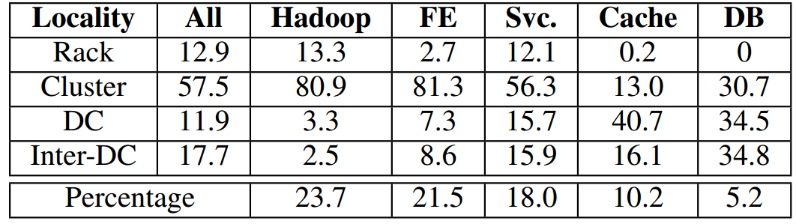

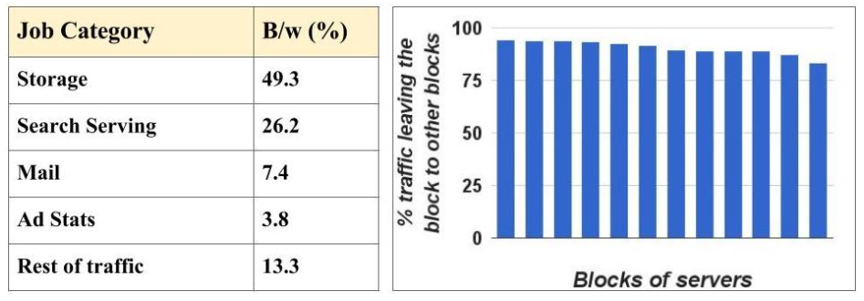

Traffic characteristics: rack locality
Facebook
“Inside the Social Network’s (Datacenter) Network”
Arjun Roy et al., ACM SIGCOMM’15
Google
“Jupiter Rising: A Decade of Clos Topologies and
Centralized Control in Google’s Datacenter Network”
Arjun Singh et al., ACM SIGCOMM’15
Notes:
all of Facebook’s machines during a 24-hour period in January 2015
13% of all traffic is rack local; 58% is cluster-local but not rack, etc.
Interestingly, inter data center traffic exceeds rack-local traffic!
In this DC, Hadoop is the largest single driver of traffic
Data from one Google cluster: different granularity (rack < block < cluster)
Block-local traffic is small
For data availability, they spread storage blocks around non-fate-sharing devices (e.g. power for one server block may be fate-sharing)

Slide 22
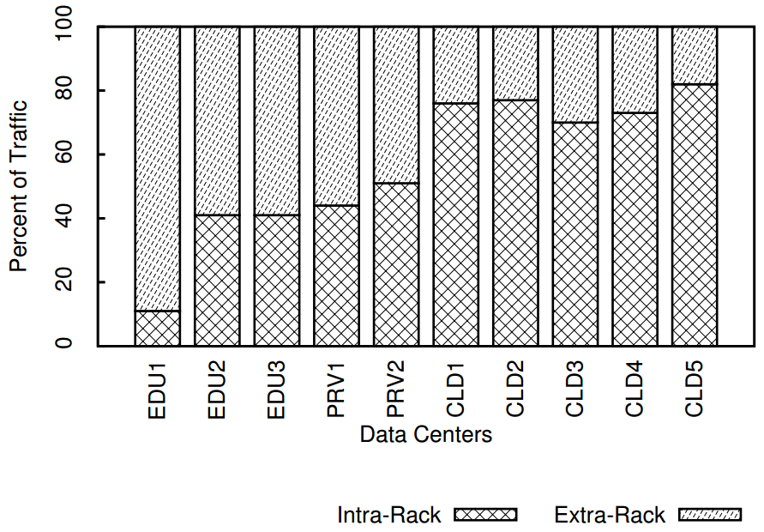

Traffic characteristics: rack locality
Rack-local traffic
“Network Traffic Characteristics of Data Centers in the Wild”
Theophilus Benson et al., ACM IMC’10
Notes:
Benson et al. evaluated 3 university clusters, 2 private enterprise networks, and 5 commercial cloud networks
univ, prv, have few hundred to 2000 servers each
CLD have 10-15k each
CLD 1-3 many apps (Web, mail, etc.) but CLD 4-5 more Mapreduce style apps
much higher rack locality here! 70%+ for the CLD4-5, which are supposedly Mapreduce style
many possible reasons for difference:
workload differences (not all MR jobs are the same!)
different ways of organizing storage and compute
5 year gap: perhaps people are just doing things differently now; or maybe app sizes have grown so substantially …
different scale

Slide 23
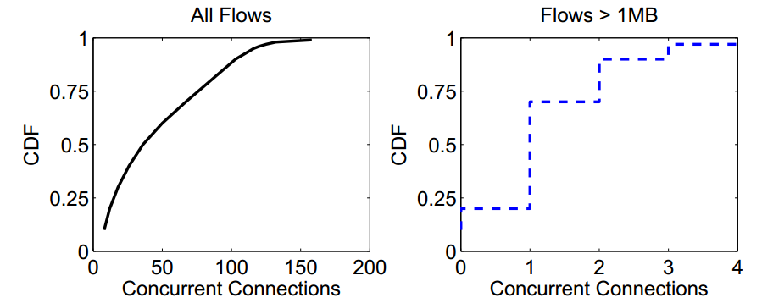
Traffic characteristics: concurrent flows
“Web servers and cache hosts have 100s to 1000s of concurrent connections”
Facebook
“Inside the Social Network’s (Datacenter) Network”
Arjun Roy et al., ACM SIGCOMM’15
“Hadoop nodes have approximately 25 concurrent connections on average.”
1500 server cluster @ ??
“median numbers of correspondents for a server are two (other) servers within its rack and four servers outside the rack”
“The Nature of Datacenter Traffic: Measurements & Analysis”
Srikanth Kandula et al. (Microsoft Research), ACM IMC’09
Microsoft web search
“Data Center TCP (DCTCP)”
Mohammad Alizadeh et al., ACM SIGCOMM’10
Notes:
FB: 100s-1000s (paper also notes, grouping by destination host doesn’t reduce these numbers by more than a factor of two)
Very different number for Hadoop hosts
Another measurement of a 1500 server cluster running MR style jobs found only 2-4 destinations / server
Lessons: (a) differences across applications; (b) even MR jobs are not created all the same

Slide 24
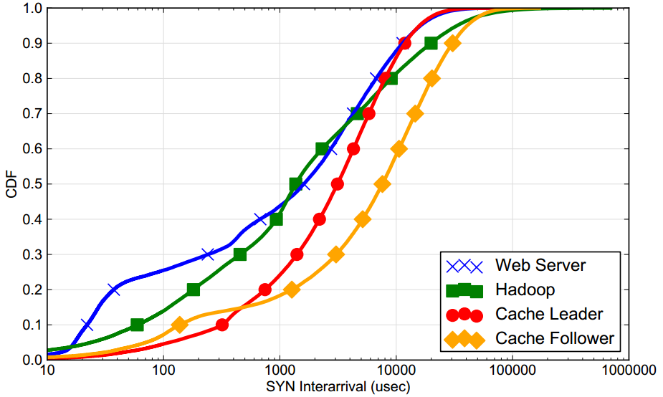
Traffic characteristics: flow arrival rate
“median inter-arrival times of approximately 2ms”
Facebook
“Inside the Social Network’s (Datacenter) Network”
Arjun Roy et al., ACM SIGCOMM’15
1500 server cluster @ ??
< 0.1x Facebook’s rate
“The Nature of Datacenter Traffic: Measurements & Analysis”
Srikanth Kandula et al. (Microsoft Research), ACM IMC’09
Notes:
at both Hadoop and Web servers, FB reports flow inter-arrival times at a server of around 2ms in the median
The mystery cluster has inter arrival times in the tens of milliseconds
Note: with a 1000 server cluster, overall arrival time would be in the microseconds.

Slide 25
Traffic characteristics: flow sizes
Hadoop: median flow <1KB
Facebook
<5% exceed 1MB or 100sec
“Inside the Social Network’s (Datacenter) Network”
Arjun Roy et al., ACM SIGCOMM’15
Caching: most flows are long-lived
… but bursty internally
Heavy-hitters ≈ median flow, not persistent
1500 server cluster @ ??
> 80% of the flows last <10sec
> 50% bytes are in flows lasting less <25sec
“The Nature of Datacenter Traffic: Measurements & Analysis”
Srikanth Kandula et al. (Microsoft Research), ACM IMC’09
Notes:
Most Hadoop flows are very small
For caching, long-lived flows, but only transmit data burstily
Heavy hitters are not too much larger than median flow rate, not persistent, i.e., present instantaneous h.h. not heavy soon after
Here there’s some agreement between data sets, but the news is largely negative: TE difficult
Some part of it (at least for Web / caching servers) is that app-level load balancing is doing the work (heavy hitters similar to median)

Slide 26
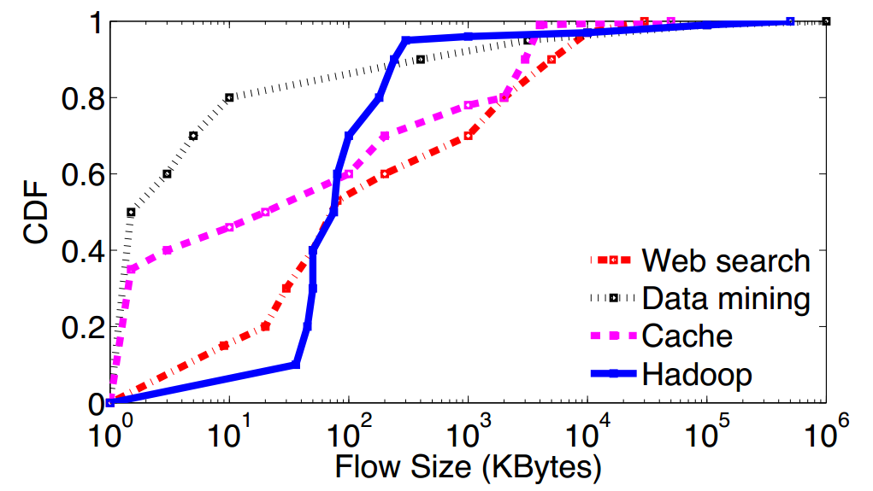
Traffic characteristics: flow sizes
Fig. from
“MQECN”, USENIX NSDI’16
Web search
Data mining
Cache, Hadoop
“DCTCP”, ACM SIGCOMM’10
“VL2”, ACM SIGCOMM’09
“Inside Facebook DCN”, ACM SIGCOMM’15
Notes:
Most Hadoop flows are very small
For caching, long-lived flows, but only transmit data burstily
Heavy hitters are not too much larger than median flow rate, not persistent, i.e., present instantaneous h.h. not heavy soon after
Here there’s some agreement between data sets, but the news is largely negative: TE difficult
Some part of it (at least for Web / caching servers) is that app-level load balancing is doing the work (heavy hitters similar to median)

Slide 27
What does data center traffic look like?
It depends … on applications, scale, network design, …
… and right now, not a whole lot of data is available.
Notes:
so where do we go from here?
well, there are some conclusions we can draw from the nature of data center applications and by points of agreement across the measurements.

Slide 28
Implications for networking
1
Data center internal traffic is BIG
2
Tight deadlines for network I/O
3
Congestion and TCP incast
4
Need for isolation across applications
5
Centralized control at the flow level may be difficult
Notes:
We’ll look at some of these in more detail.

Slide 29
Implications for networking
1
Data center internal traffic is BIG
Need high-throughput intra-DC network
“Jupiter Rising: A Decade of Clos Topologies and Centralized Control in Google’s Datacenter Network”, Arjun Singh et al. @ Google, ACM SIGCOMM’15
“Introducing data center fabric, the next-generation Facebook data center”, @ Facebook, 2014 Facebook official blog
Notes:
this growth is driving the need for big, high capacity DCNs
need to do this cheaply, scalably, in a fault tolerant manner
want high capacity network design, efficient routing

Slide 30
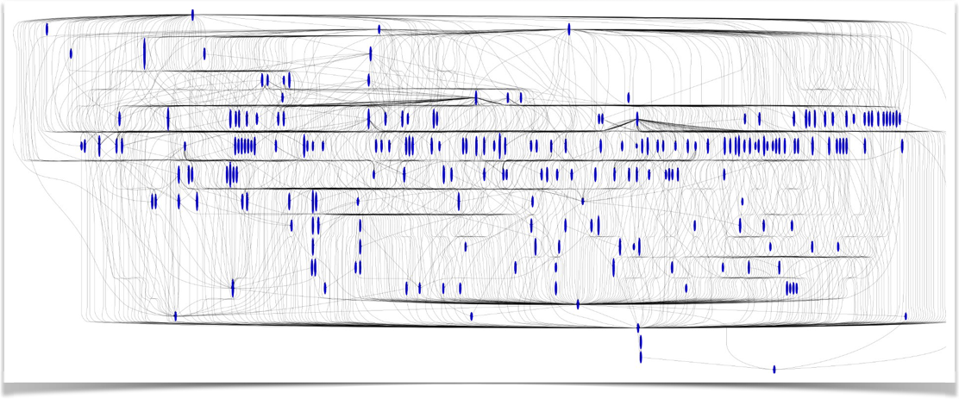
Implications for networking
2
Tight deadlines for network I/O
Notes:
Applications like Web search impose tight latency requirements

Slide 31
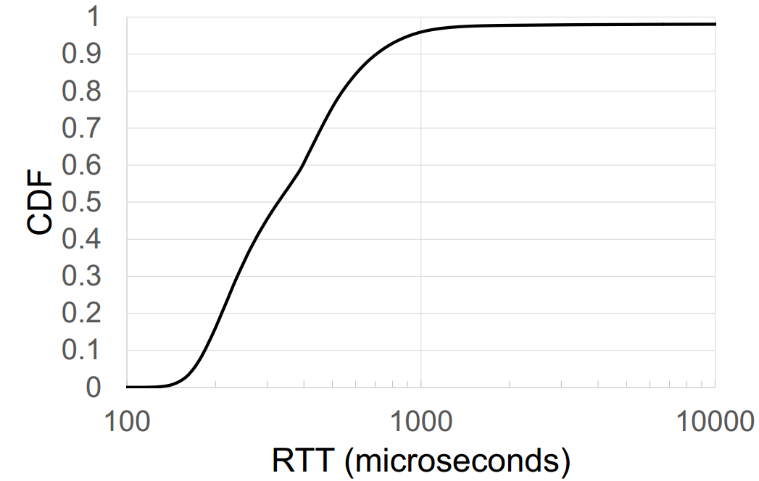
Implications for networking
2
Tight deadlines for network I/O
Suppose: server response-time is 10ms for 99% of requests; 1s for 1%
#Servers | Requests 1s or slower
1 | 1%
100 | 63%
10ms (99th)
Measured by me, at Microsoft production DC, 2015
330us (50th)
Need to reduce variability and tolerate some variation
Notes:
Internal deadlines of ~10ms are common, including the application logic! Network envelope is small! Can’t afford excessive queuing delays
Further, tail latency really matters …
To use an example from Google’s Jeff Dean … blah blah
Given what we noted earlier about each request generating … 100 requests internally is not that large, and obviously, problem gets worse with #requests

Slide 32
Implications for networking
3
Congestion and TCP incast
TCP does not work very well
Notes:
large numbers of flows sharing bandwidth
scatter-gather also creates incast … (more detail in later lesson)
long queues increase latencies and the variance
various app-layer fixes, but ultimately complicate app logic

Slide 33
Implications for networking
4
Complex network shared by applications
Applications with different objectives sharing the network
Notes:
Isolation across applications
possibly multiple tenants (in cloud setting)

Slide 34
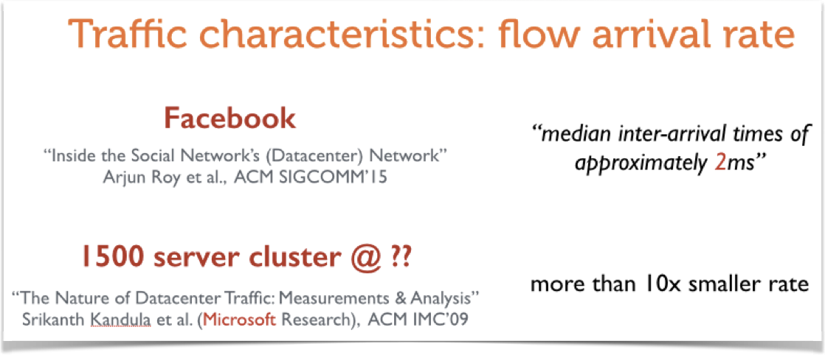
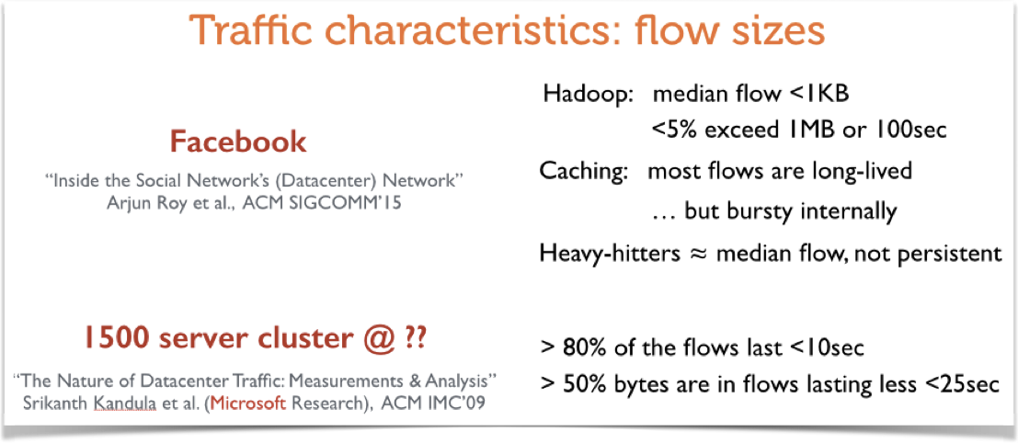
Implications for networking
5
Centralized control at the flow level may be difficult
Distributed control, perhaps with some centralized tinkering
Notes:
large flow rates
with short flows
very hard to scale any type of centralized flow control

Slide 35
Reading materials for group projects
“Inside the Social Network's (Datacenter) Network”, SIGCOMM 2015
“The Nature of Datacenter Traffic: Measurements & Analysis”, IMC 2009
“Network traffic characteristics of data centers in the wild”, IMC 2010 (dataset partially available)
“Scaling Memcache at Facebook”, NSDI 2013
“Speeding up Distributed Request-Response Workﬂows”, SIGCOMM 2013
“Profiling Network Performance for Multi-Tier Data Center Applications”, NSDI 2011

Slide 36
Thanks!
陈果 副教授
湖南大学-信息科学与工程学院-计算机与科学系
邮箱：guochen@hnu.edu.cn
个人主页：1989chenguo.github.io

